Slide 1
Q4 CAR Analysis
Team:
Alan Purvey
Kai Huang
Matt Marotto

Slide 2
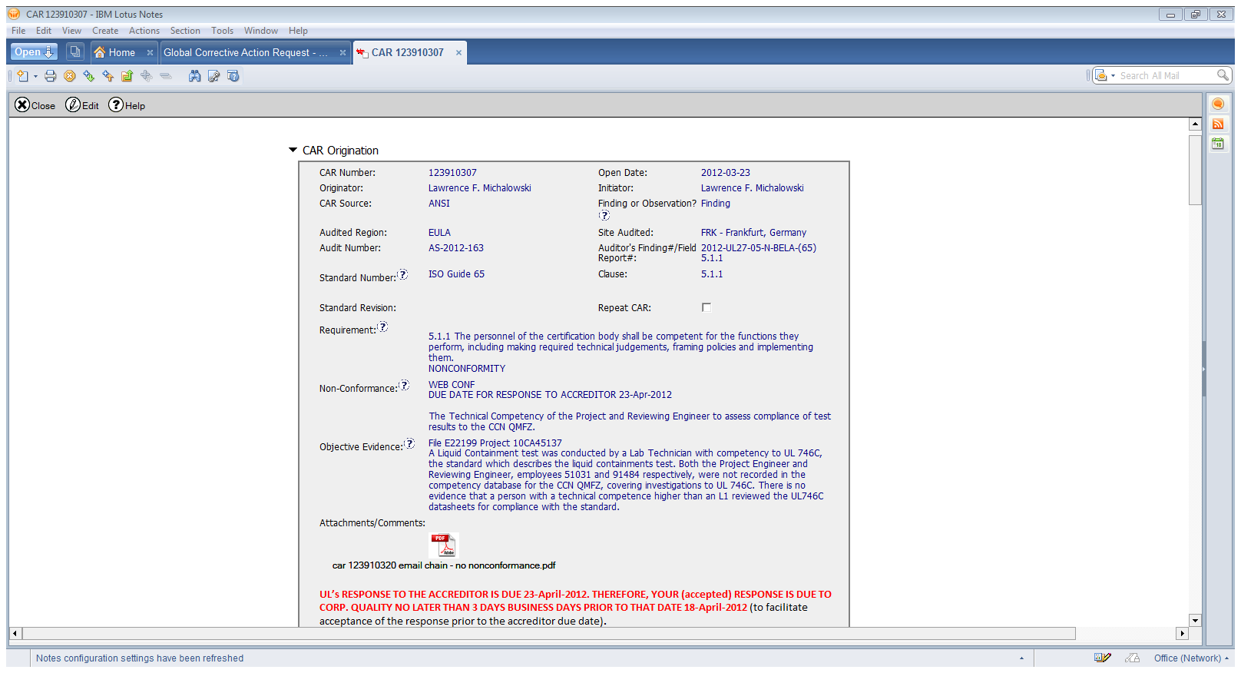
Finding: Good CAR
Background:

Slide 3
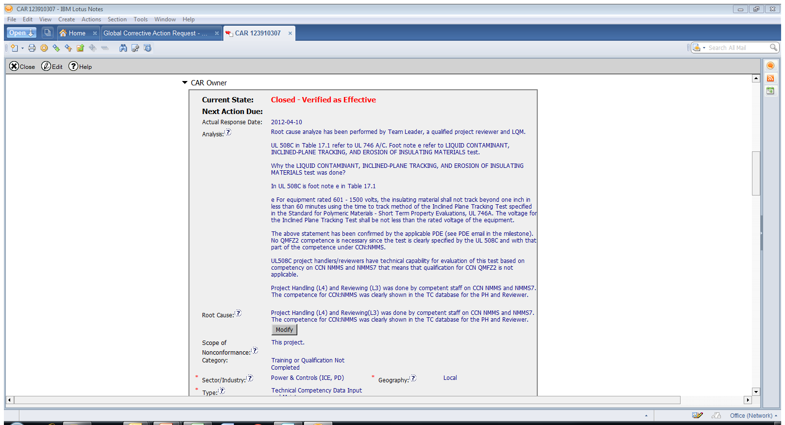
Finding: Good CAR
Indicates Stakeholders that were consulted
Detailed analysis includes technical overview of relationship between test methods and standards
CAR owner consulted with PDE, included email response
Root cause analysis summarizes overall analysis, and confirms competency

Slide 4
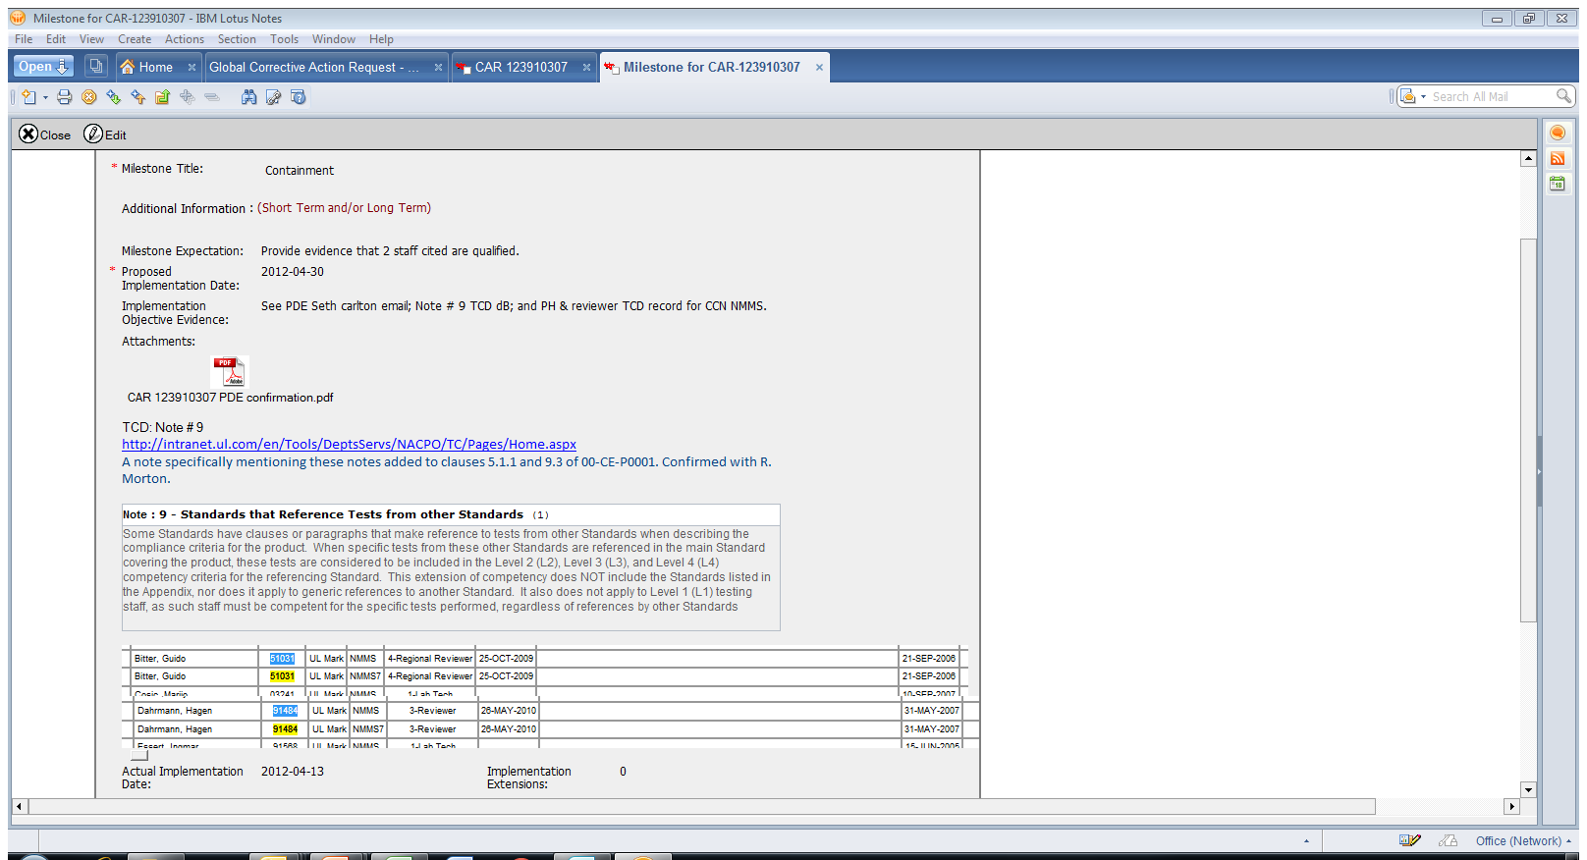
Finding: Good CAR
Milestone included additional detail from SOP and confirmation with additional staff consulted as part of the Objective Evidence

Slide 5
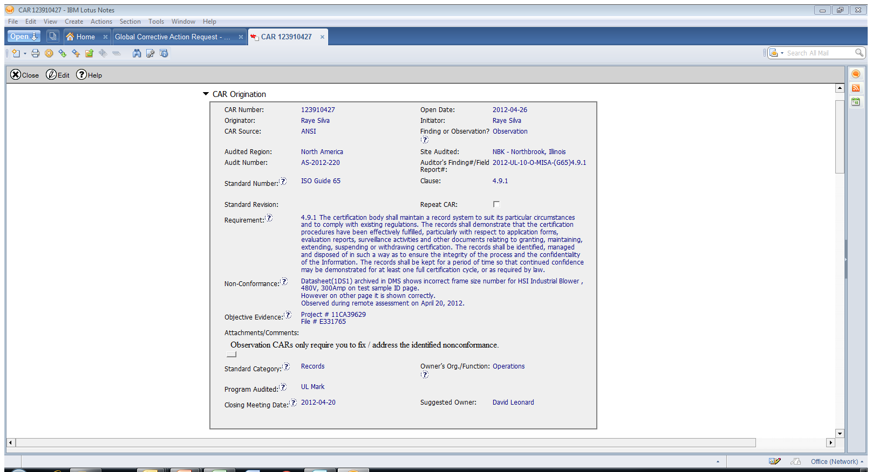
Observation: Good CAR
Background:

Slide 6
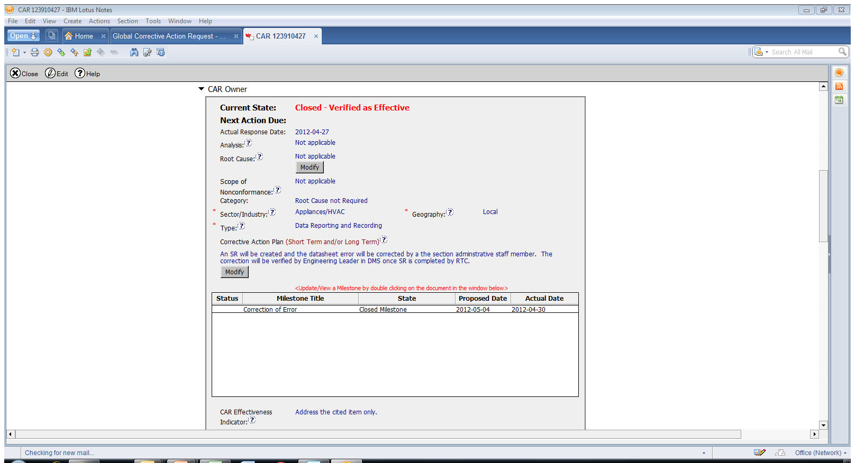
Observation: Good CAR
Corrective Action was established to directly address the non-conformance

Slide 7
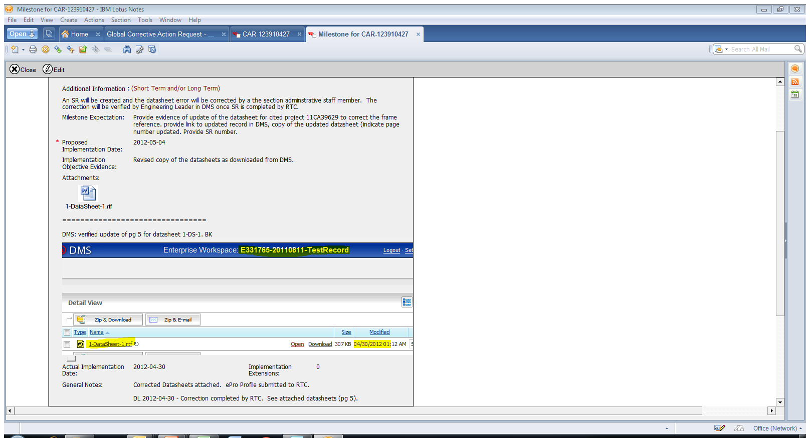
Observation: Good CAR
Milestone addresses correction of data sheet and includes a link to the document in DMS
Milestone also includes verification by Engineering Leader and provides audit trail by requesting an SR

Slide 8
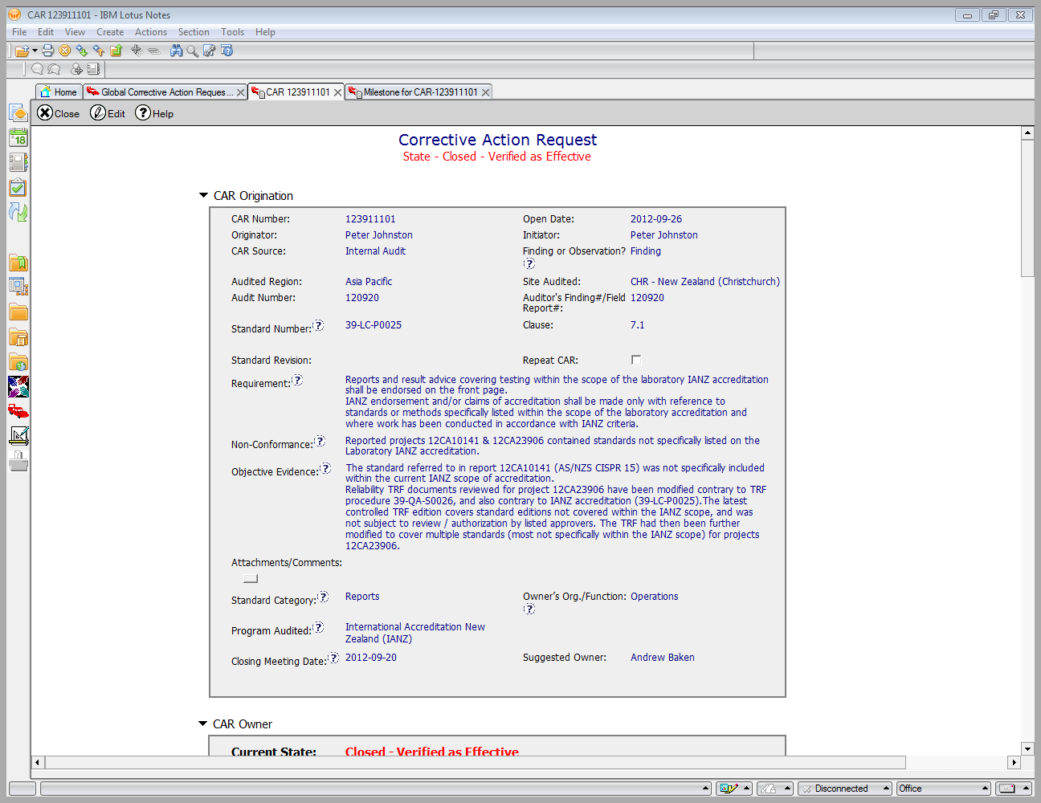
Finding: Improvement CAR
Background:

Slide 9
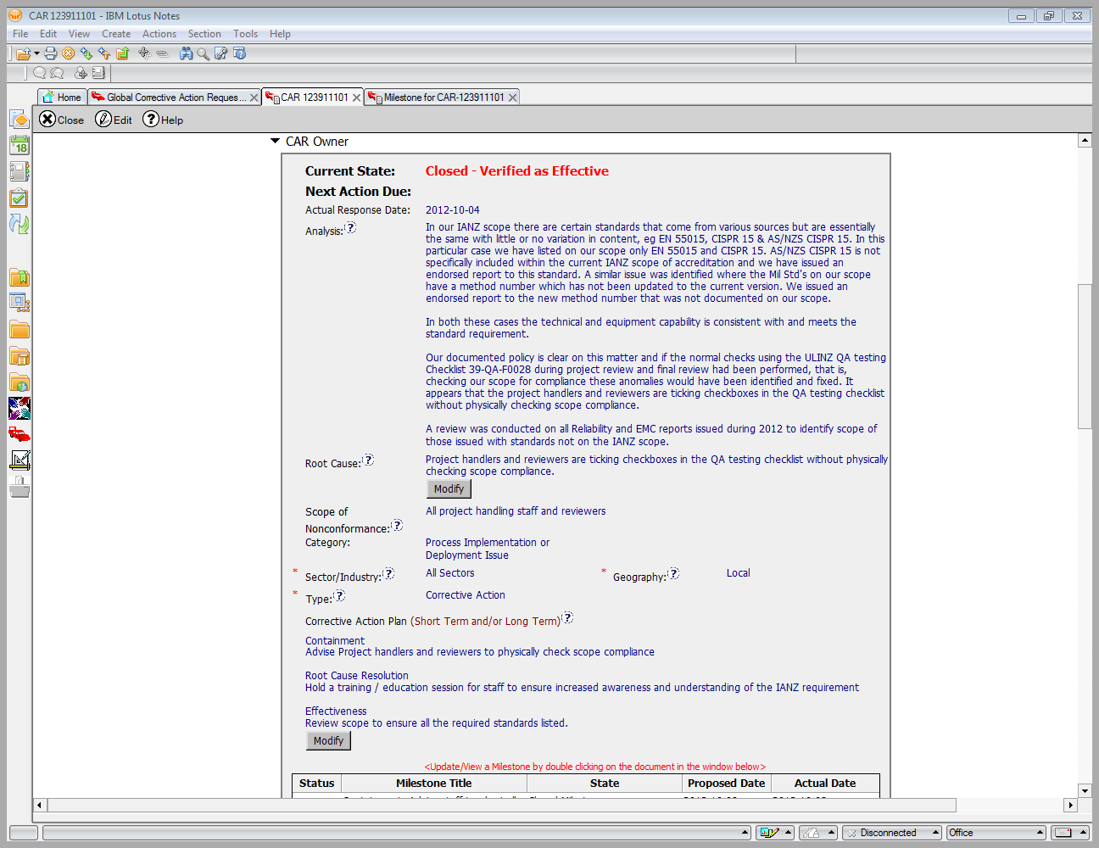
Finding: Improvement CAR
No mention of stakeholders consulted as part of analysis
CAR analysis assumes that engineers are not checking the scope, however, there was no objective evidence submitted to reinforce this assumption

Slide 10
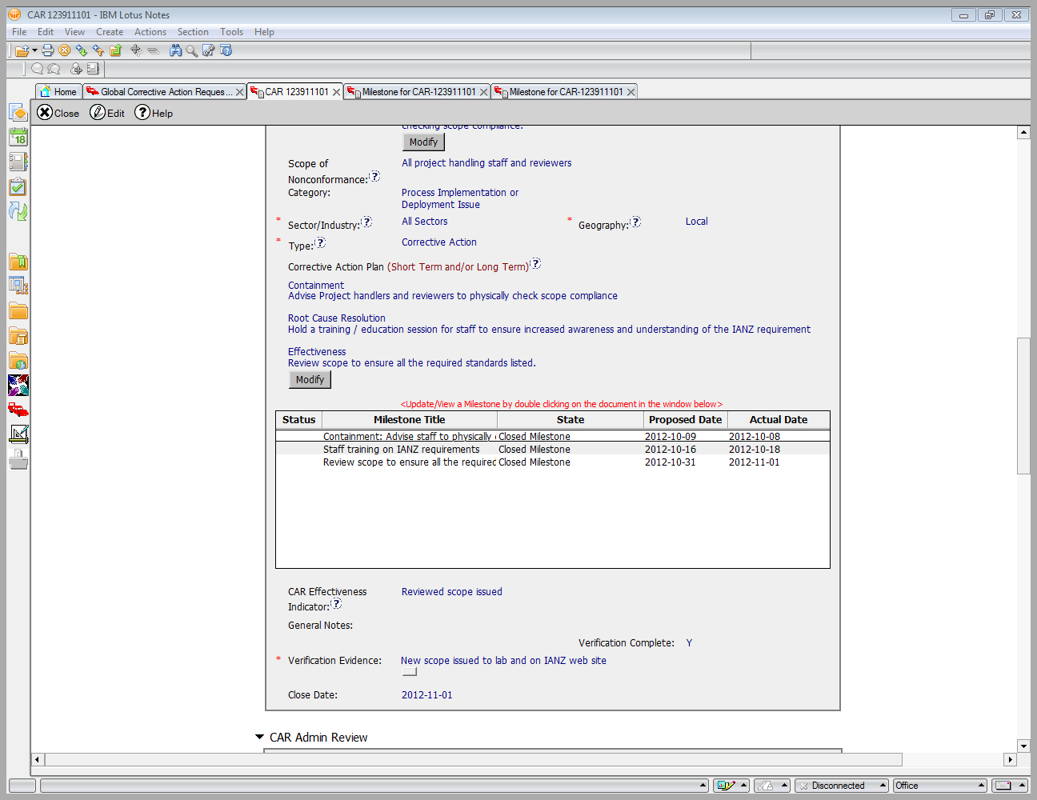
Finding: Improvement CAR
Verification step was not designed to determine if the Corrective Action prevented future reoccurrences

